Slide 1
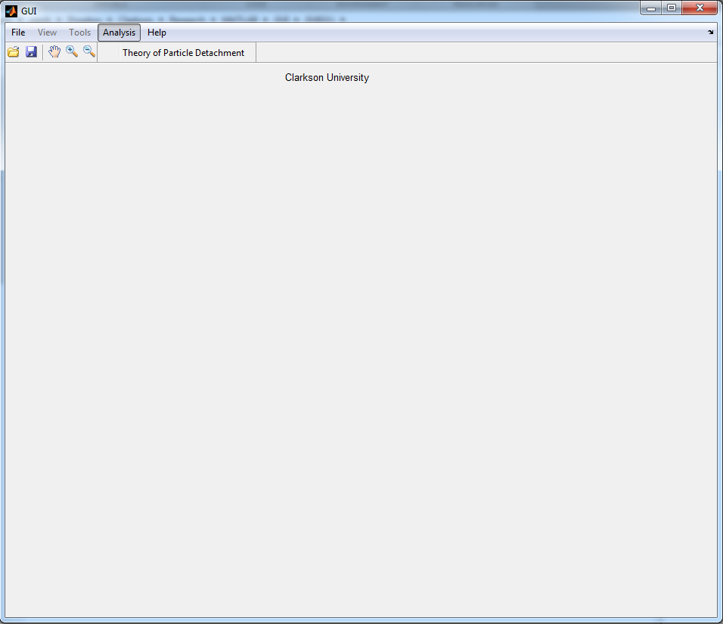
Theory tool

Slide 2
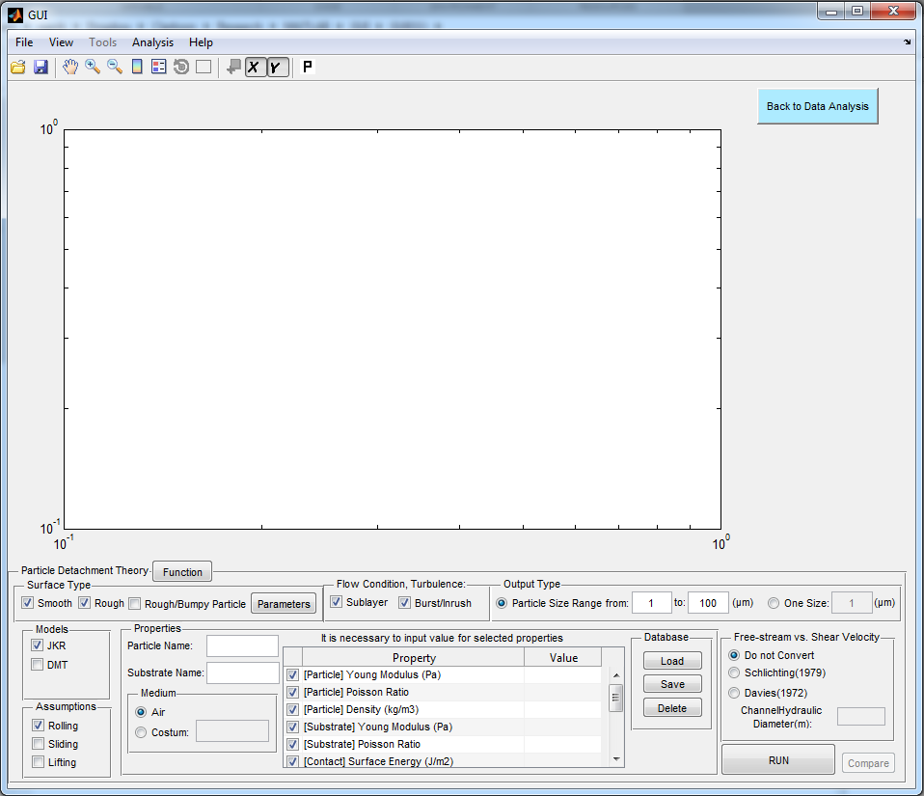
Select Different Condition and models to calculate corresponding necessary critical velocity for specific particle size range detachment

Slide 3
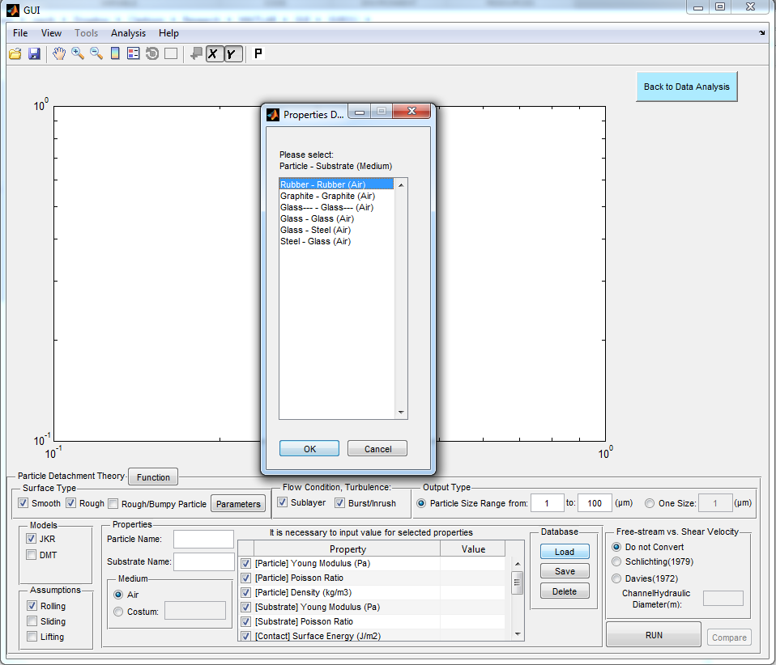
Input or load Material properties form interactive database
2
3
1

Slide 4
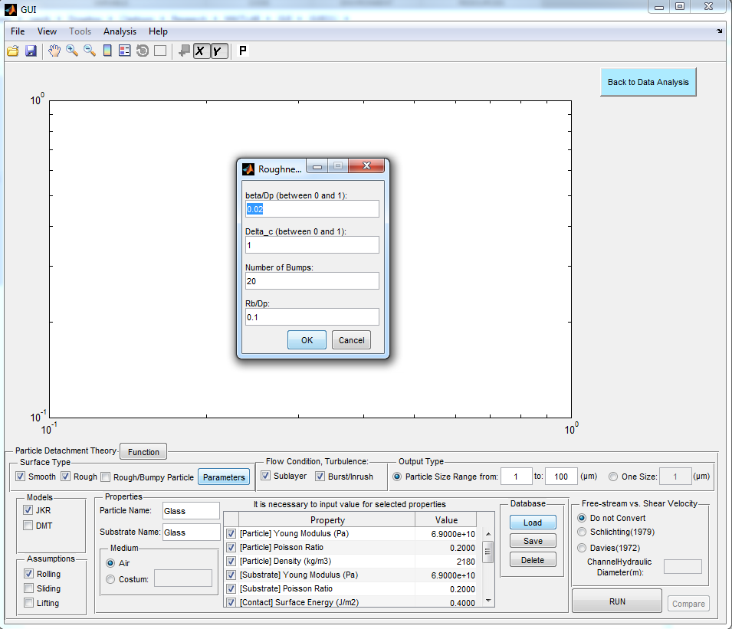
Some Roughness and Bumpy Model Parameters input
2
1
At the end

Slide 5
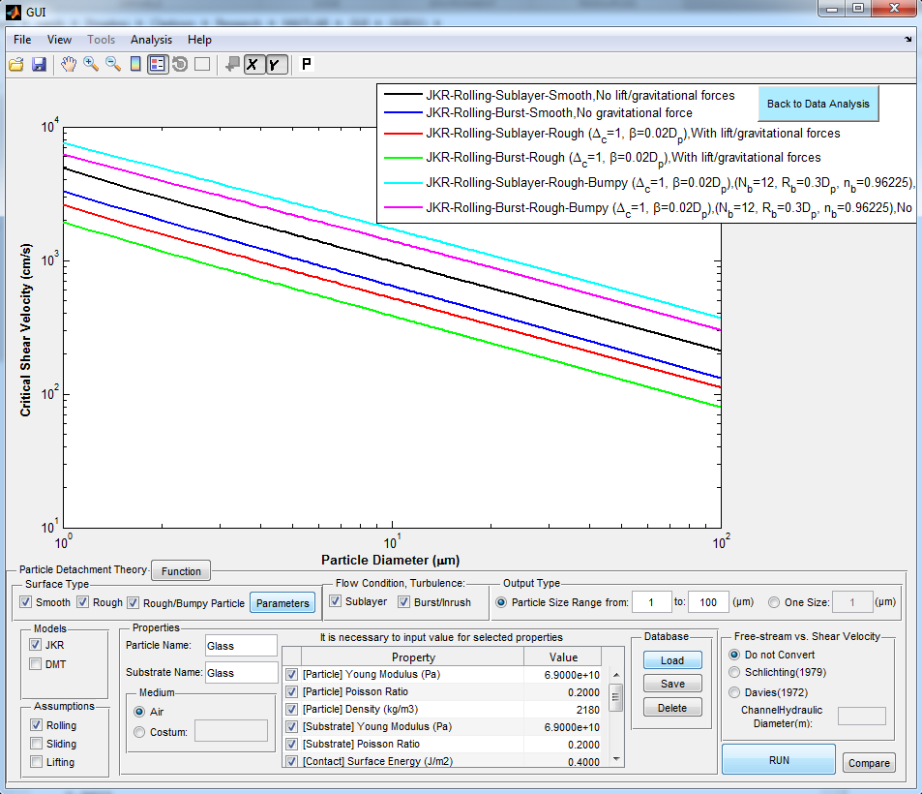

Slide 6
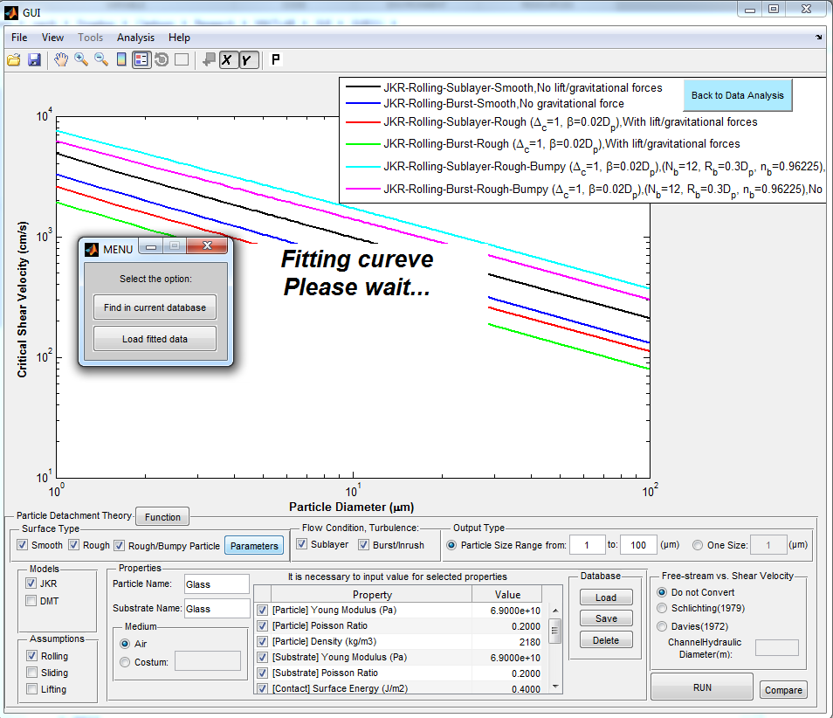
2
1

Slide 7
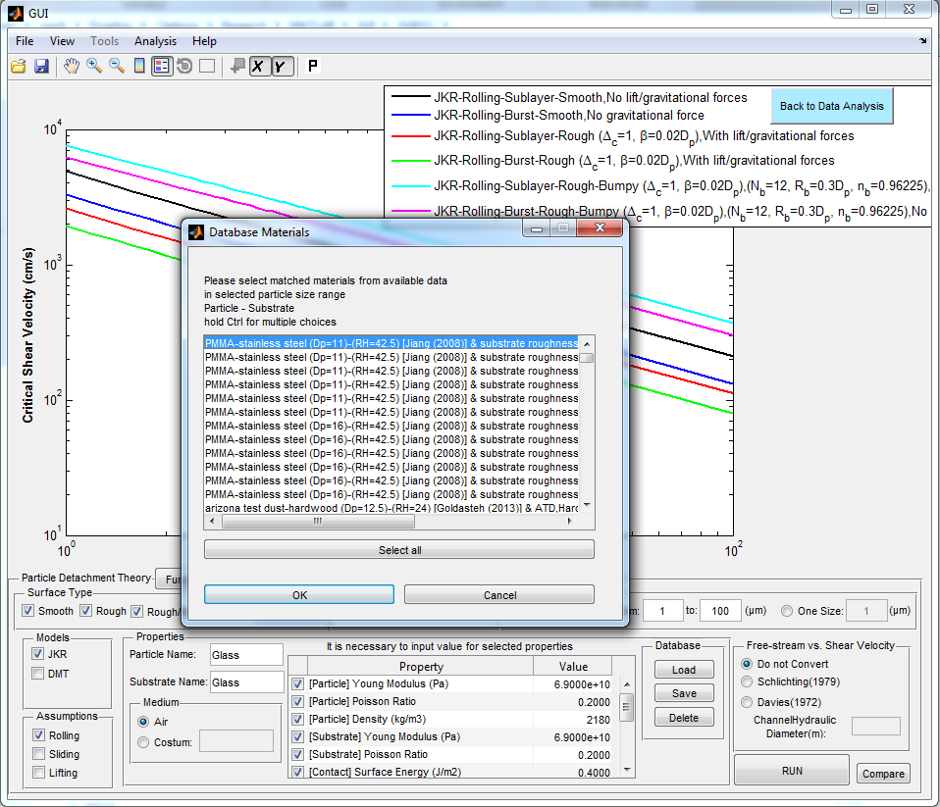
List of Experiments that cumulative distribution has been fitted on.
Example:
Select Glass on Glass data

Slide 8
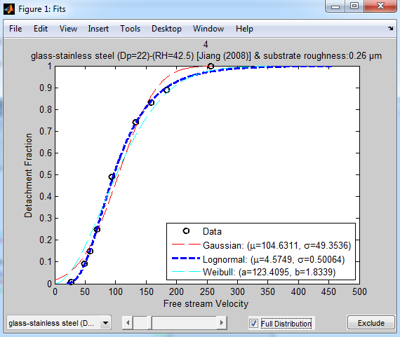
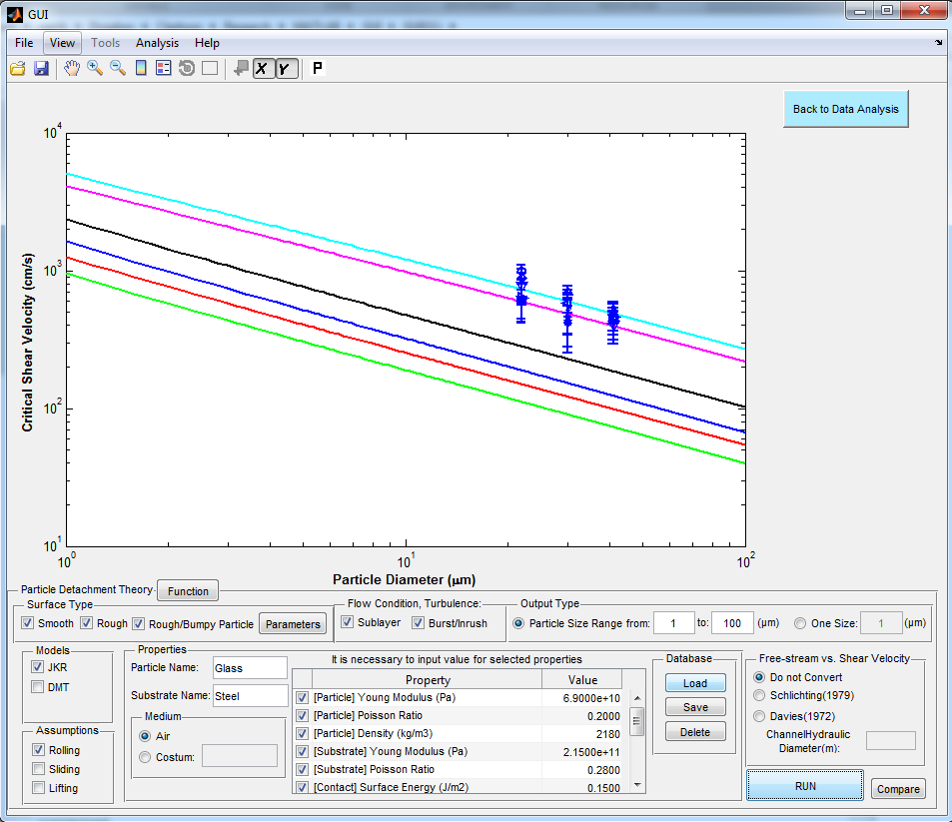
Compare Theory with Experimental data points, also with fitting distributions information for each dataset.

